Slide 1
The BGP Analyst's Notebook
17 Years In
Doug Madory
Head of Internet Analysis, Infoblox

Slide 2
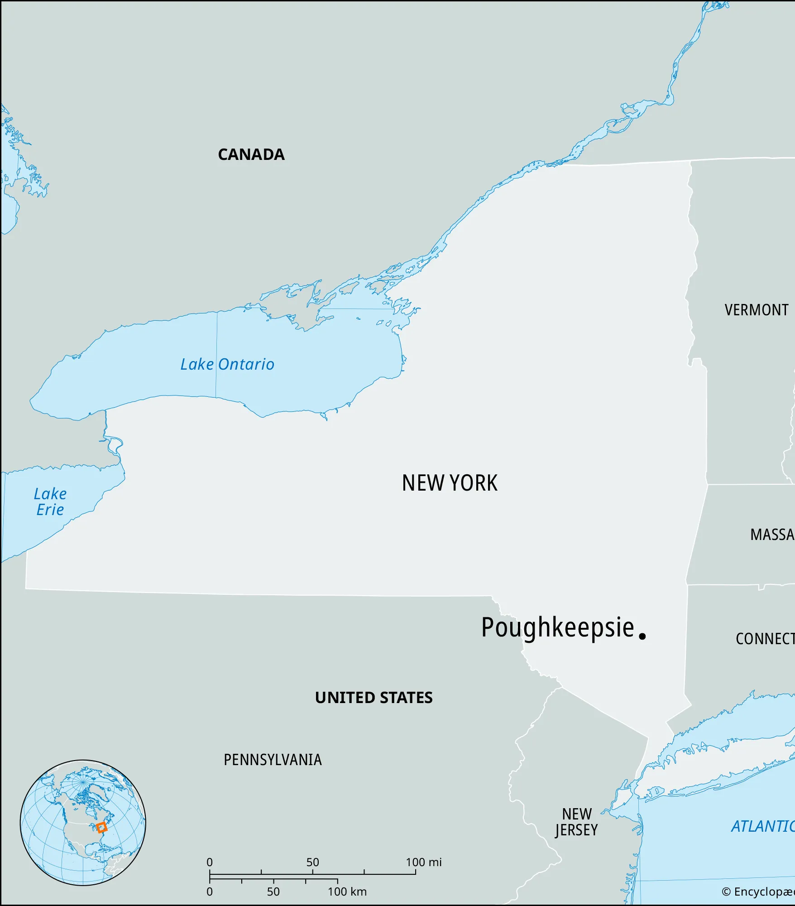


About Me
Native of Poughkeepsie, New York
  Father was an engineer at IBM.
  Mother was a journalism major.
Attended Univ. of Virginia on ROTC scholarship.
Later Dartmouth for a master’s degree.

Slide 3
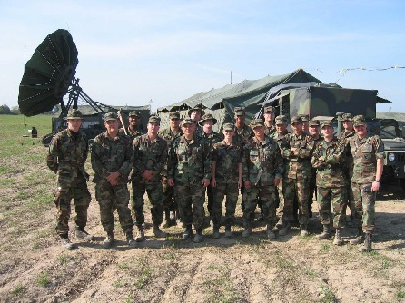
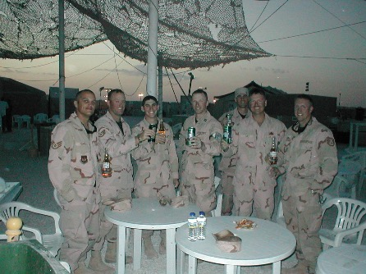
About Me
5+ years as a communications engineer in US Air Force
NATO Air Meet (Sep 2003)
Poznan, Poland
Al Udeid Air Base, Qatar (Mar 2004)
(following deployment to Iraq)

Slide 4


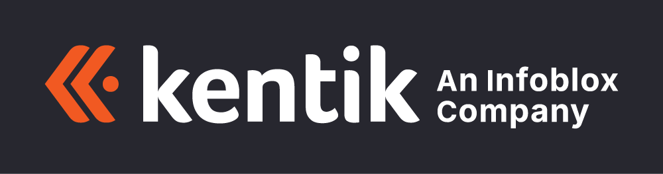
About Me
Started work on BGP analysis in 2009
Renesys (small startup working on Internet measurement)
  Dyn Research after acquisition by Dyn (2014)
  Oracle Internet Intelligence after acquisition by Oracle (2017)
Kentik (since 2020)
  Acquired by Infoblox (Aug 2026)

Slide 5
Doug’s approach to BGP analysis

Slide 6
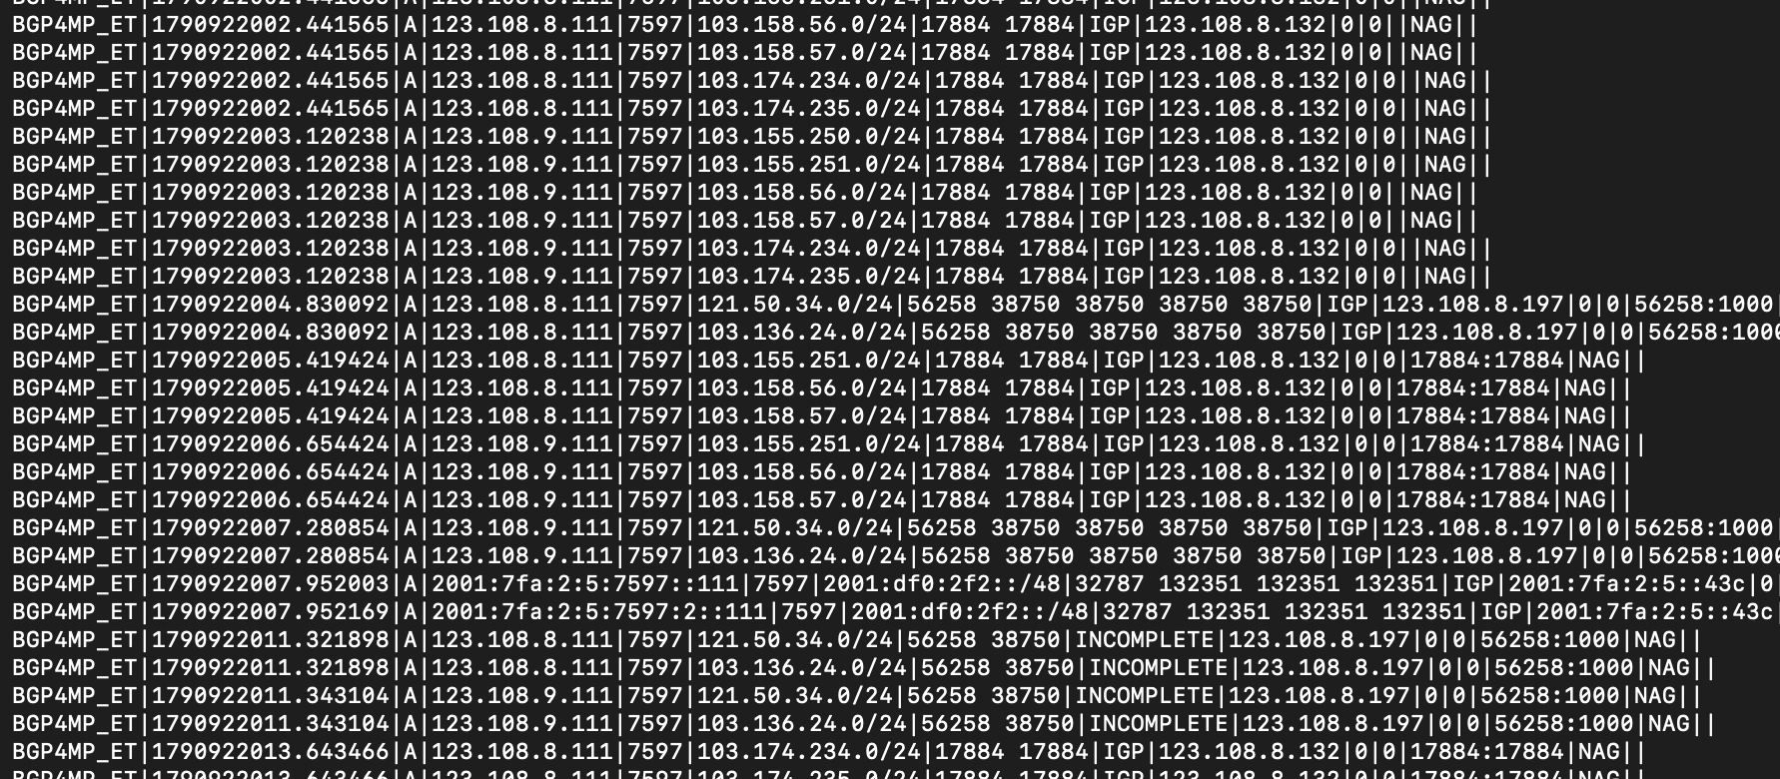
How do we turn this into insight about routing?

Slide 7
My approach to BGP analysis
Challenge:
  Understanding BGP dynamics is a highly dimensional problem.
For any BGP event, we wish to understand three things:
  Scope (i.e. How far did it propagate? What is the footprint?)
  Duration (i.e. How long did it last?)
  Context (i.e. What were the ASes involved?)

Slide 8
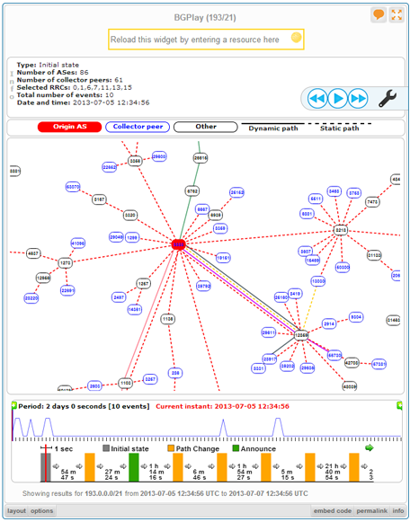
My approach to BGP analysis
BGPlay still used today, but animating individual announcements doesn’t meet our goals.
  Need to gain insight without watching an extended animation.
Counts of announcements are also weak measures of a BGP event.
  Could be nothing, could be something
  If it’s something, what is it? 🤷

Slide 9
My approach to BGP analysis
Goal: Estimate how the Internet’s routing tables change over time.
  We’re also trying to merge many views.
Shift focus from individual announcements to the hidden state.
  Announcements just the observables of that hidden state.
We must keep state and pay the computational cost.
  What is the state of the route for each AS over time.

Slide 10
Let’s take an example:
What happened to 37.148.92.0/24 during 14:00-16:00 UTC on Sep-8?

Slide 11
What happened to 37.148.92.0/24 during 14:00-16:00 UTC on Sep-8?
If you start by plotting all the AS-AS edges of the route at the beginning of the timeline with RouteViews, it is unreadable.

Slide 12
What happened to 37.148.92.0/24 during 14:00-16:00 UTC on Sep-8?
If you start by plotting all the AS-AS edges of the route at the beginning of the timeline with RouteViews, it is unreadable.
You either must greatly reduce the number of BGP sources you use (sacrificing information) or …
Prune the ball-and-stick.
  Insight: most of the activity you care about is closer to the origin.
  Drawing every AS edge wastes time and space.
  Allows the use of nearly unlimited BGP sources.

Slide 13
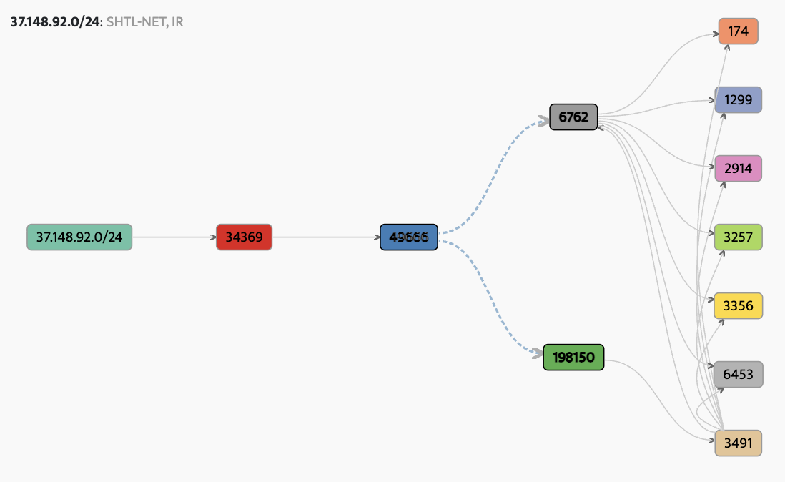
What happened to 37.148.92.0/24 during 14:00-16:00 UTC on Sep-8?
By restricting the ball-and-stick to things seen by ~1% of BGP sources, you focus on what matters most.
becomes

Slide 14
What happened to 37.148.92.0/24 during 14:00-16:00 UTC on Sep-8?
This covers “context” but not scope and duration.
For those, we’ll need something else.

Slide 15
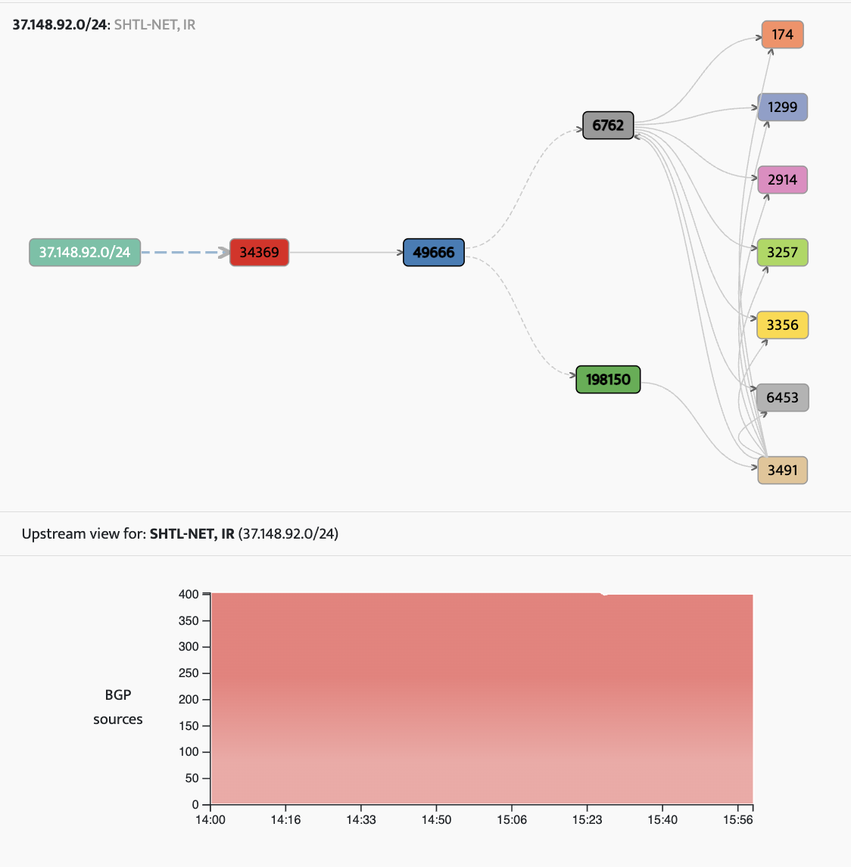
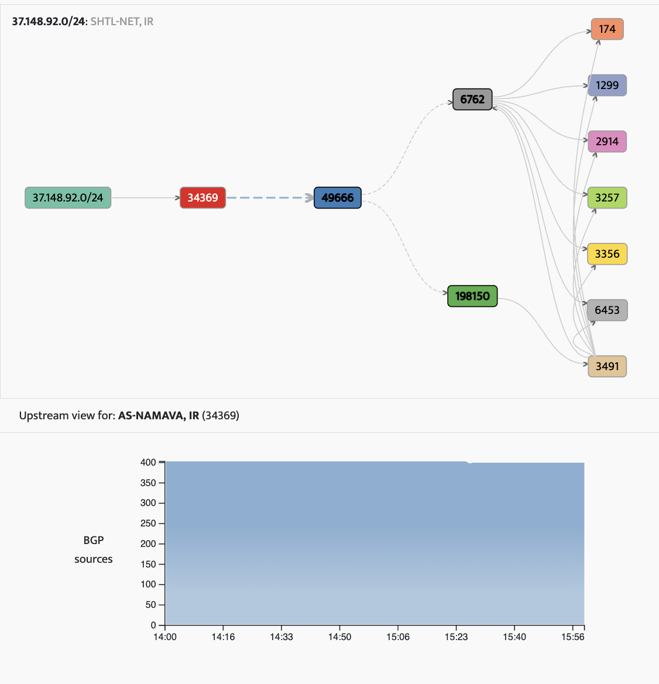


What happened to 37.148.92.0/24 during 14:00-16:00 UTC on Sep-8?
For years I’ve used these stack plots to represent the aggregate views of large numbers of BGP sources.
In this case, one can see that not much changed in the origination of this prefix or in the first hop of transit.
We can’t limit ourselves to just activity at the origin or first-level upstream.
Origin view for 37.148.92.0/24
Upstream view for AS34369

Slide 16
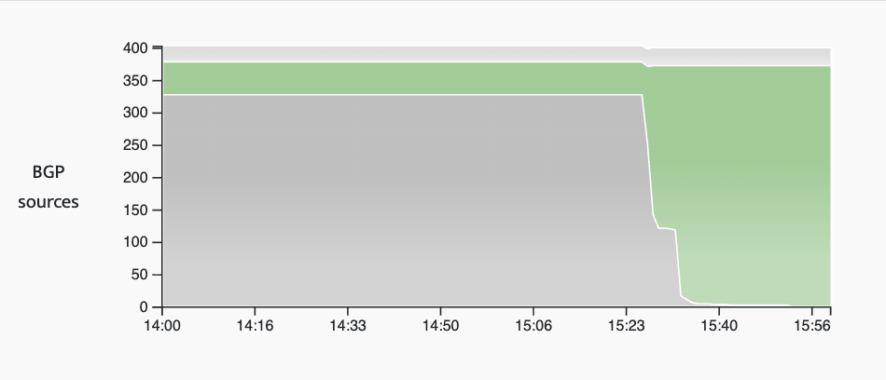
What happened to 37.148.92.0/24 during 14:00-16:00 UTC on Sep-8?
But if we search far enough, we can instantly see that normally AS49666 has primarily two upstreams however AS6762 dropped away beginning at 15:26 UTC being completely replaced by AS198150.
1025 update messages processed.
  Not necessary to know this!
  We’re focused on the change in hidden state, not the count of messages.
Upstream view for AS49666

Slide 17
What happened to 37.148.92.0/24 during 14:00-16:00 UTC on Sep-8?
This is how we can address scope, duration and context in a single analytical approach.
More than just a visualization, it is an approach to understanding dynamism in BGP.
Upstream view for AS49666

Slide 18
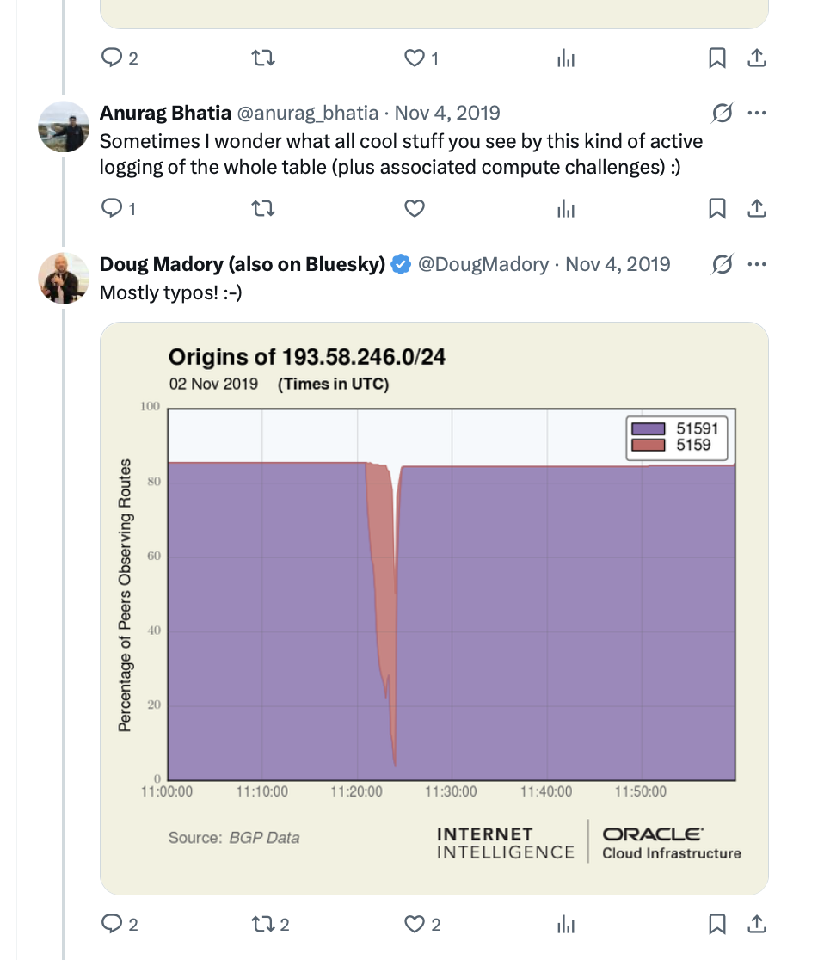
Nov 4, 2019
Anurag Bhatia:
Sometimes I wonder what all cool stuff you see by this kind of active logging of the whole table (plus associated compute challenges) :)
Me:
Mostly typos! :-)

Slide 19
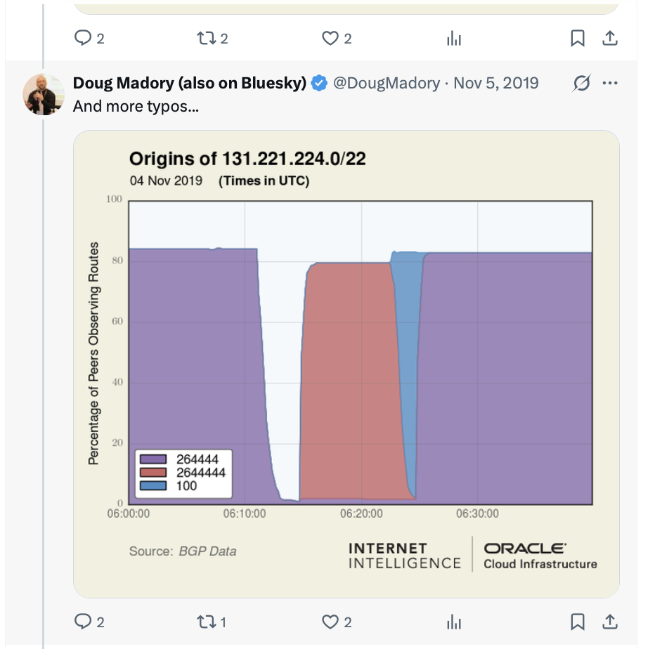

Slide 20
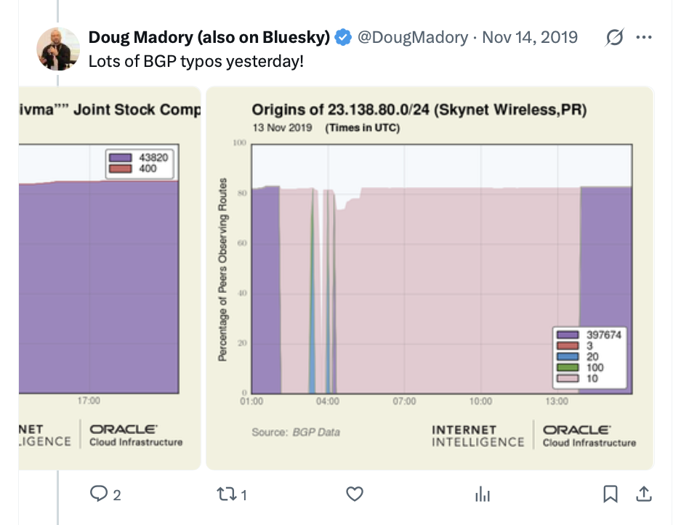

Slide 21
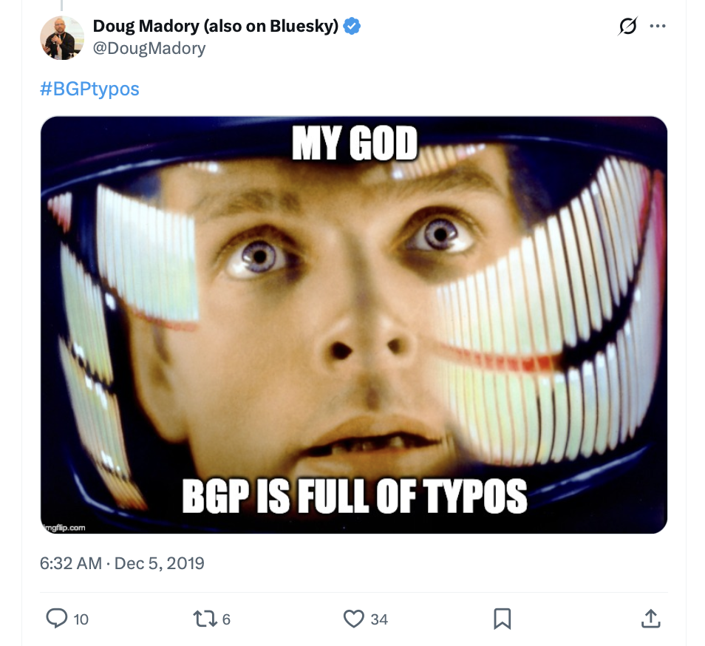


Slide 22
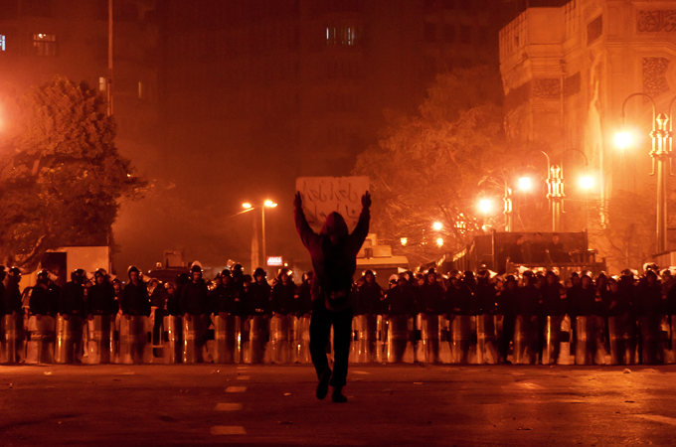
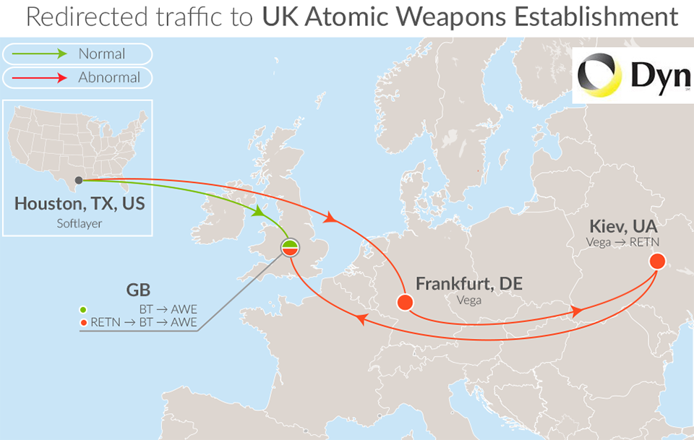
My analysis falls into two buckets
Geopolitical
BGP security

Slide 23
My analysis falls into two buckets
Geopolitical
BGP security

Slide 24
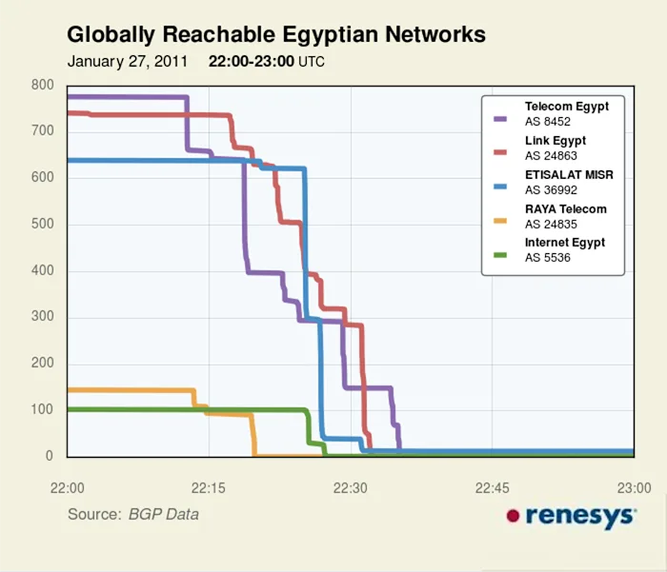
Geopolitical: Internet shutdowns
Egyptian shutdown (Jan 2011)
  Ushered in the era of “digital authoritarianism” still with us today.
Initial techno-optimism was misplaced.
  Costs of shutdowns irrelevant to dictator.
  Diverse international links not a panacea.
  Emergence of digital rights community and rapid innovation of circumvention tech.
Numerous shutdowns since Egypt.
  A problem that will unfortunately continue.

Slide 25
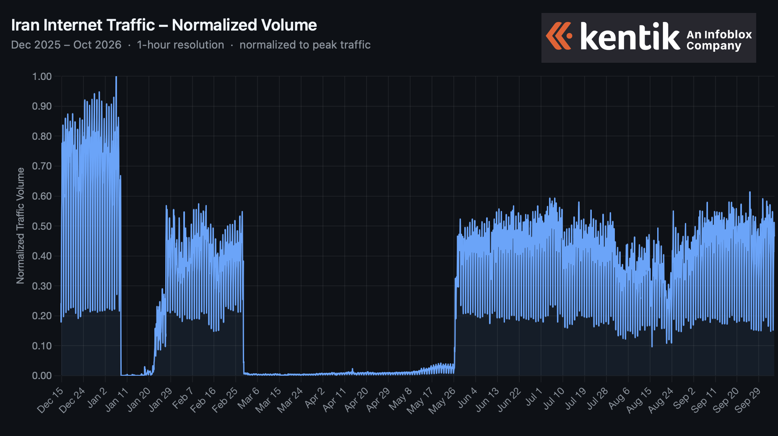
Geopolitical: Internet shutdowns
Iran shutdowns of 2026
  Most impactful shutdown in history.
  BGP routes stayed up, country offline.
  Filtering implemented through GFW-like capability.
Various attempts to mitigate costs.
  Nightly Internet curfews (2022)
  National domestic Internet (NIN)
  Allowlisting (2026)

Slide 26
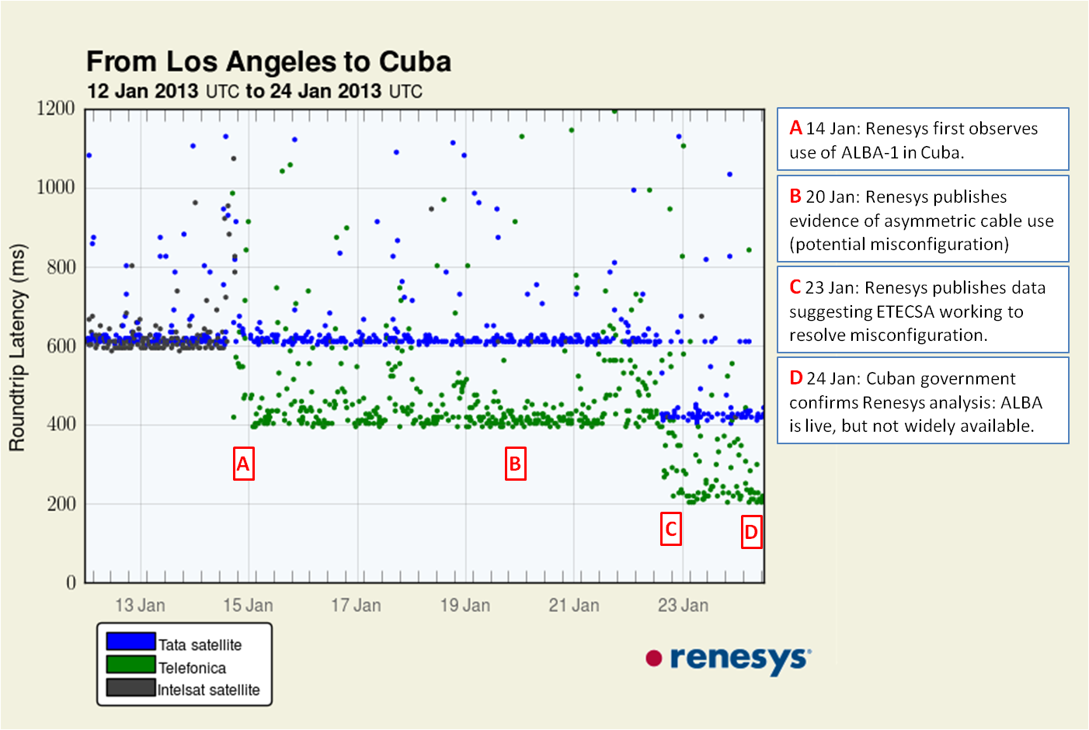
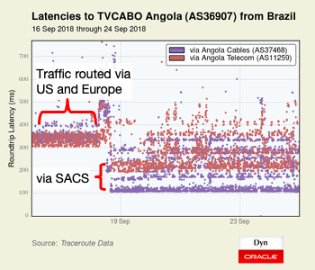
Geopolitical: ALBA-1 submarine cable activation
Published the first evidence of the activation of the first subsea cable connecting Cuba to the Internet. (Jan 2013)
  Spotted a new BGP adjacency for ETECSA (AS11960), confirmed with traceroutes.
At LACNIC 30 in Rosario, I presented the first evidence of the activation of SACS, the first operational submarine cable across the South Atlantic.

Slide 27
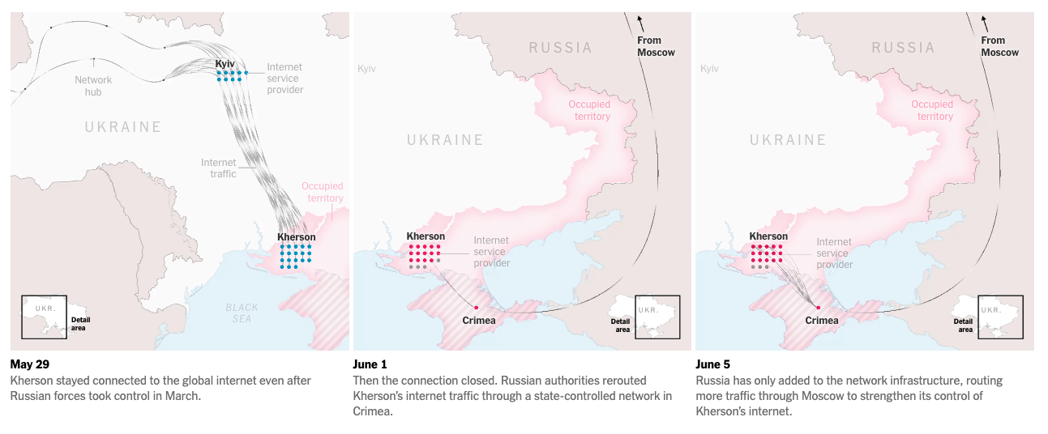

Geopolitical: Kherson switchover to Russian transit
March 2014: Russia annexed Crimean Peninsula from Ukraine
Crimea Internet re-routed via Miranda Media (AS201776) in July 2014.
Kherson Internet re-routed via AS201776 in June 2022.
How Russia Took Over Ukraine’s Internet in Occupied Territories
(New York Times, Aug 9)
All Kherson ISPs switch to Russian transit beginning June 1, 2022.
https://www.nytimes.com/interactive/2022/08/09/technology/ukraine-internet-russia-censorship.html
https://www.kentik.com/blog/rerouting-of-kherson-follows-familiar-gameplan/

Slide 28
My analysis falls into two buckets
Geopolitical
BGP security

Slide 29
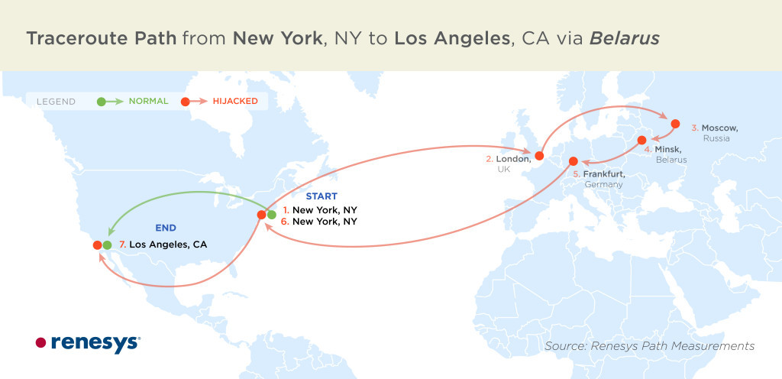
Real world attacks: BGP MITM hijacks
First documented cases of BGP MITM attacks.
  Belarus ASes hijacked many entities in Feb 2013
  Targets included:
    Visa & Mastercard
    Numerous Foreign Ministries
Motivated Renesys to build a system to detect all BGP hijacks in the routing table.
  Discovered many more.
Legacy of those early BGP attacks.
  Today, RPKI ROV and other filtering mechanisms would have stopped these.
  Public reporting tools (BGPstream, GRIP) caused hijackers to shift tactics.

Slide 30
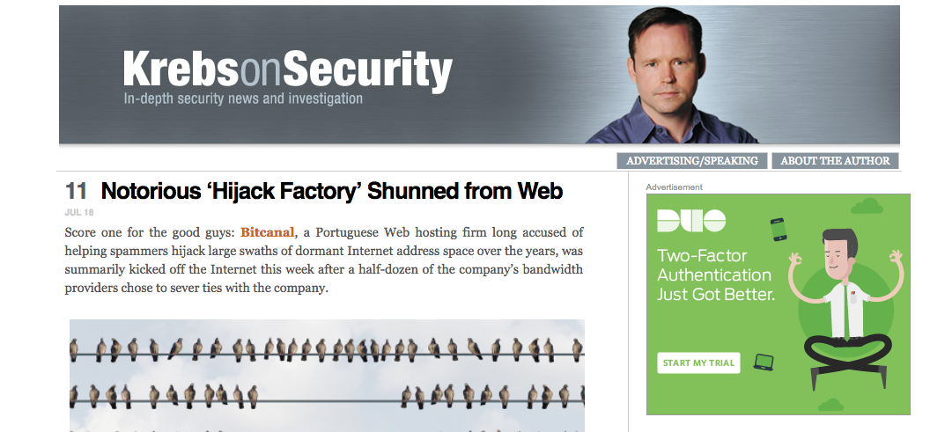
Real world attacks: Other BGP malfeasance
Disconnection of Bitcanal (AS197426)
  Platform for bad actors performing BGP hijacks.
  Disconnected from Internet by coordinated action.
Legacy of this incident:
  Unfortunately, residential proxies and IPv4 leasing have obviated the need for such a service.
  After takedown, bad actors moved to US telecoms.
Intentional, but also accidental.
  Local block leaks out
  Most famous incident: YouTube/Pakistan
  Most recent: Telegram/India
Legacy: the times have changed!
  RPKI ROV has (mostly) contained these events.

Slide 31
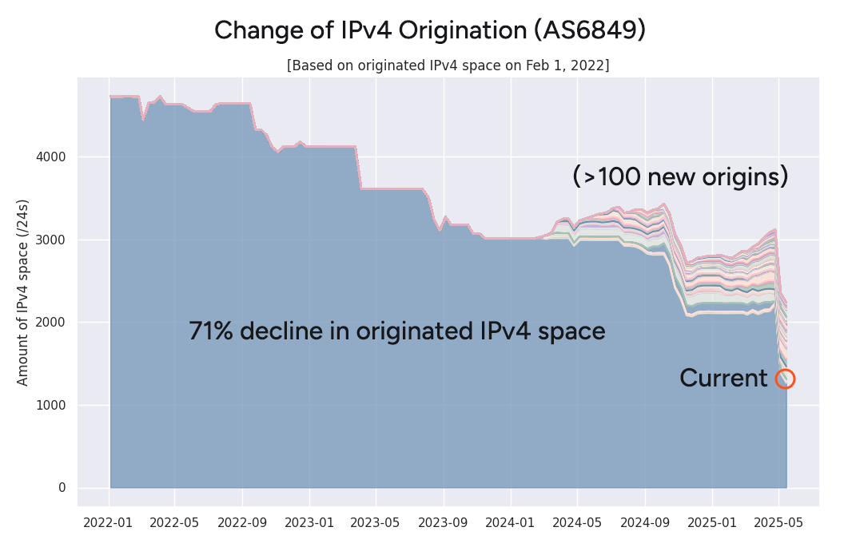
Real world attacks: IPv4 leasing and residential proxies
IPv4 private transfer market took off in 2014.
  Introduced a new player in the Internet ecosystem: the IPv4 broker.
IPv4 leasing came a few years later.
  Added the flexibility of quick, temporary usage.
  Didn’t require an RIR-mediated transfer of ownership.
Ukraine’s footprint in the global routing table shrank by 18.5% in the years following the invasion by Russia.
Ukrainian providers leasing their IPv4 for needed revenue, only to be abused by residential proxies.
  Subject of an analysis by Brian Krebs.
https://www.kentik.com/blog/from-ukraine-to-the-cloud-stories-of-ipv4-migration/
Notes:
IPv4 transfer market (2015-now)
Romanian contraction
Now untraceable leasing market (Ukraine war)
IPv6 is free and infinite, but IPv4 costs $$$

Slide 32
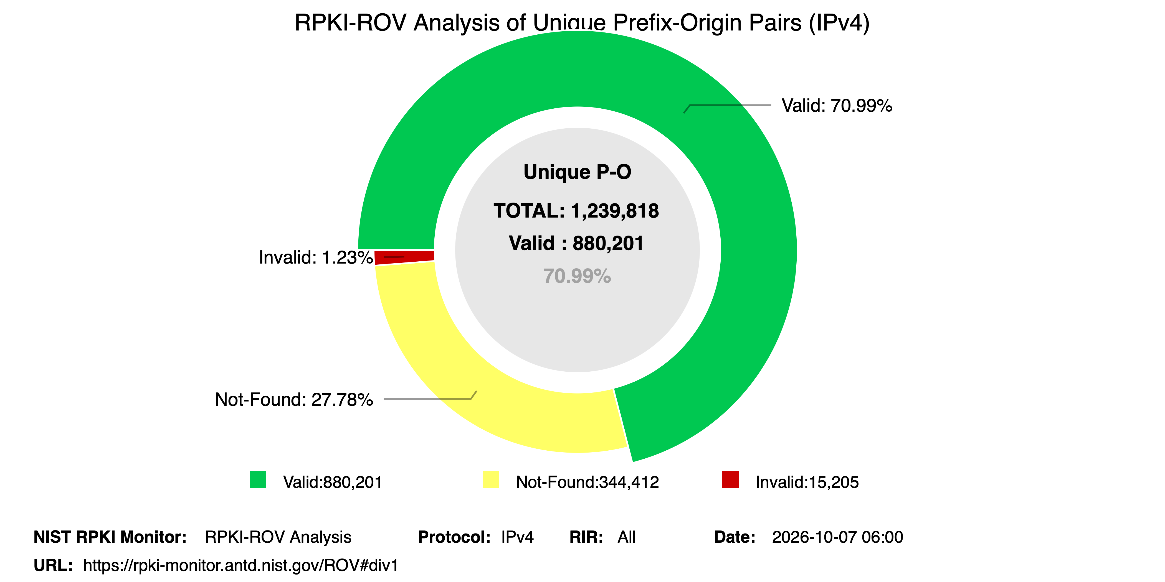
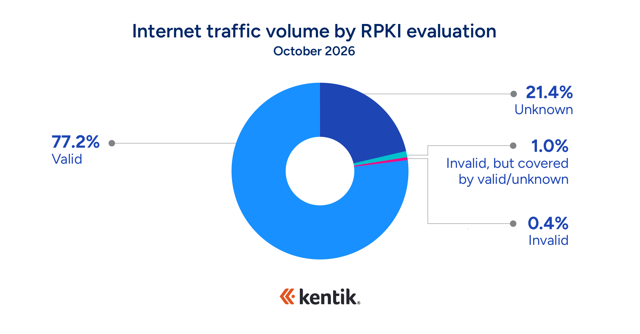
Quick Review of RPKI ROV
A ROA authorizes an origin AS (and optional maxLength) for a prefix.
ROV checks routes against ROAs and rejects invalids.
Routes with ROAs
71% of IPv4
79% of IPv6
Source NIST RPKI Monitor
Traffic to Routes with ROAs
78% bits/sec
Source: Kentik aggregate traffic data

Slide 33
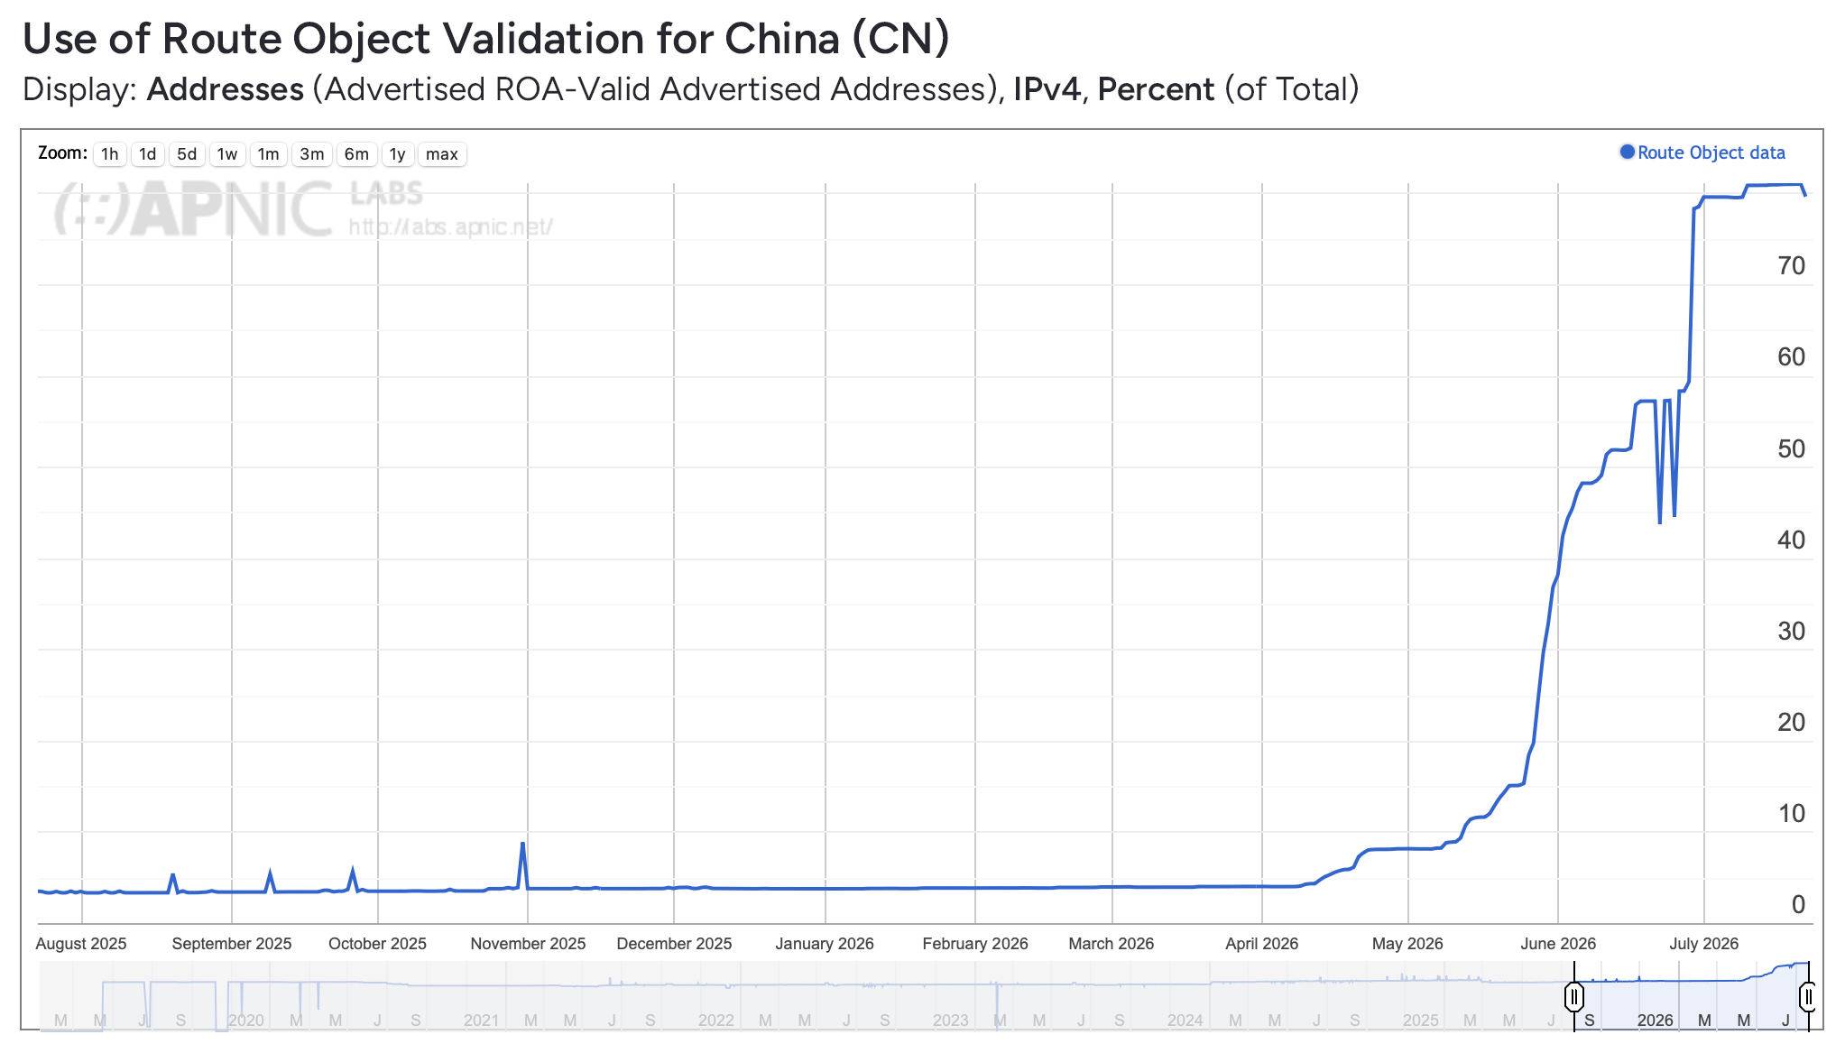
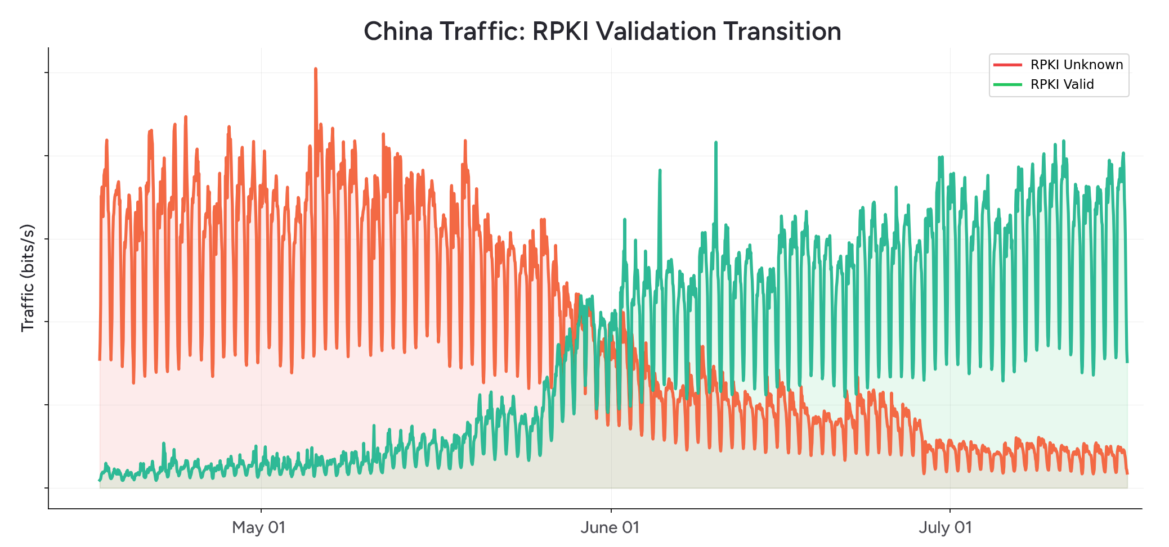
RPKI ROV: China rolls out the ROAs
China’s embrace of ROAs caused an uptick in global coverage stats.
Since April 2026, ROA coverage in China increased from 4% to 81%.
Increased ROA coverage in the APNIC region from 55% to 77%
https://www.kentik.com/blog/china-rolls-out-the-roas/

Slide 34
ASPA: Validating the Path, Beyond the Origin
ROV asks: is this AS allowed to originate this prefix?
ASPA asks the next question: does this AS path follow real business relationships?
Each network signs one ASPA object listing its upstream transit providers.
Routers check that a path climbs up through providers and comes back down only once (valley-free).
It catches two threats ROV misses:
  Route leaks (e.g., Verizon/DQE, 2019)
  Forged-origin hijacks

Slide 35
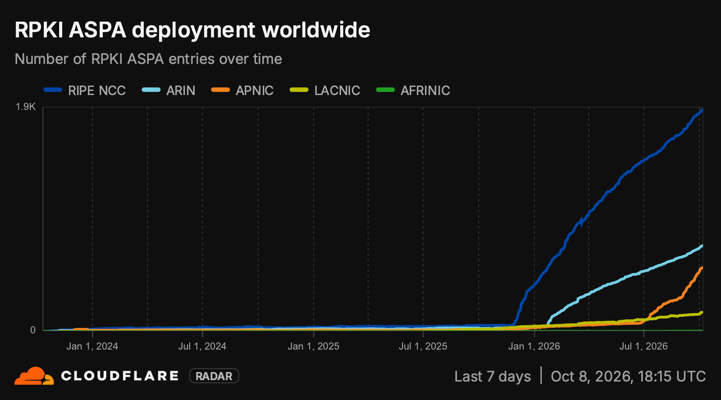
  Nov 2025: RIPE NCC turned on ASPA support in the RPKI Dashboard.
  Jan 2026: ARIN announced that ASPA “is now fully available in ARIN Online as part of the RPKI security features.”
  Jul 2026: ASPA support went live in MyAPNIC.
  Sep 2026: LACNIC added ASPA configuration to MiLACNIC.

Slide 36
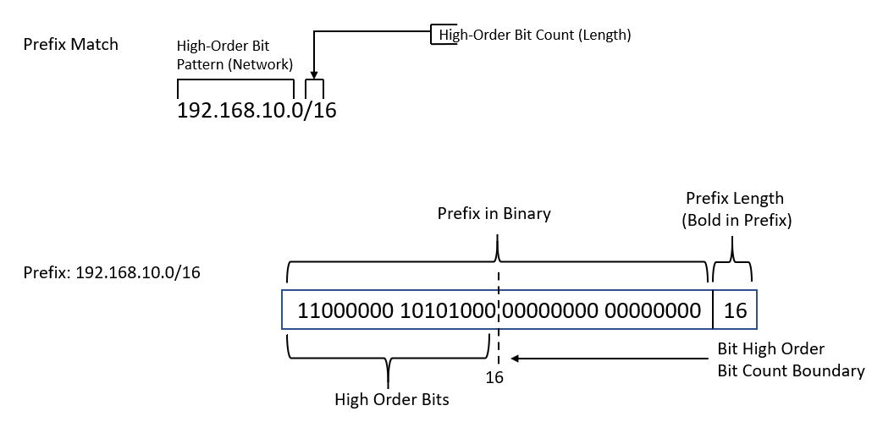
It’s time to talk about maxLength

Slide 37
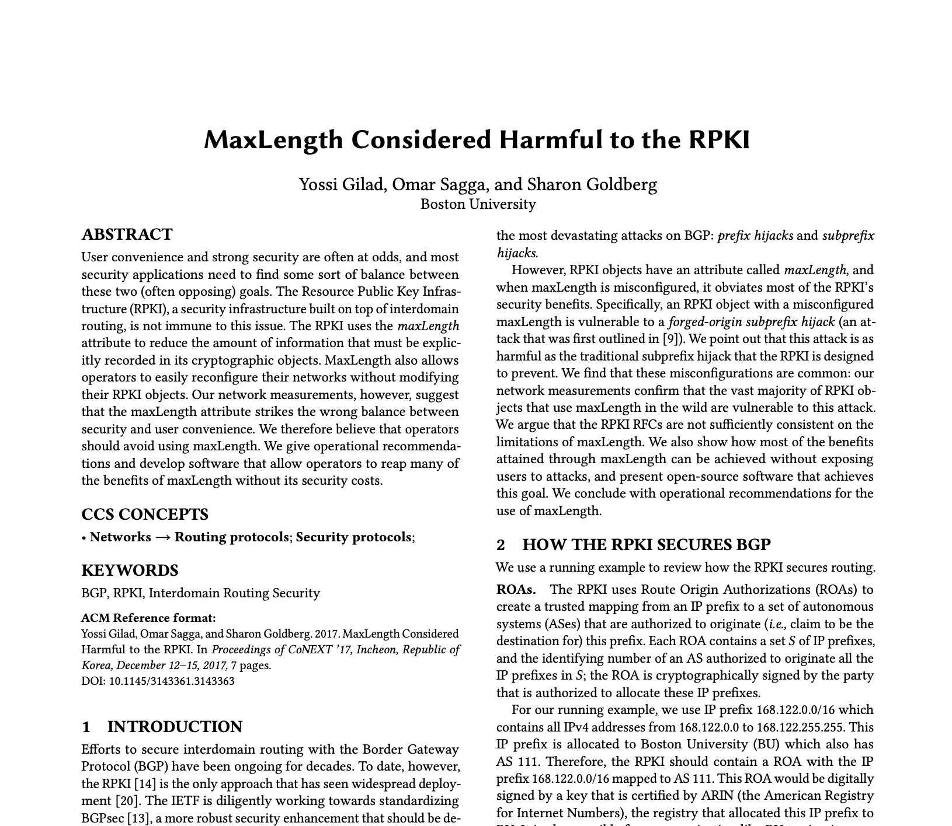
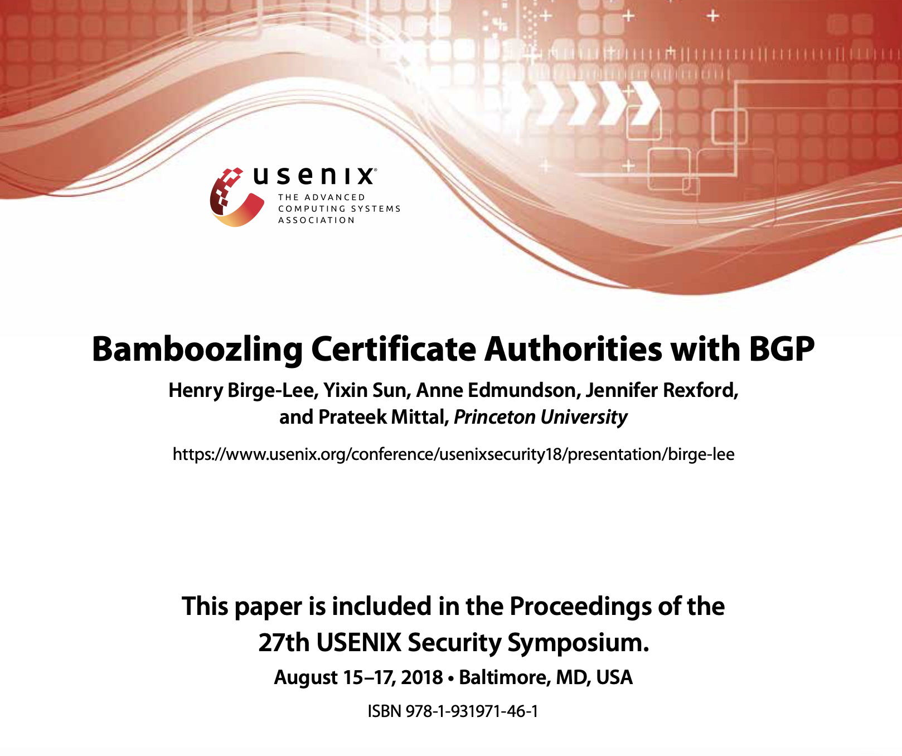
Early warnings on maxLength
2017 paper by Gilad, Sagga, and Goldberg outlined risks of overly permissive maxLength values in ROAs.
RPKI ROV could be undermined by a hijack with:
  Unannounced more-specific (subprefix) within the maxLength limit
  Forged AS path ending in the ROA's authorized origin
In 2018, Birge-Lee et al. showed how an attacker could obtain a valid TLS certificate using a BGP hijack.
  Domain validation runs over unauthenticated connections and assumes the routing system is correct.
Led to the development of Multi-Perspective Issuance Corroboration (MPIC), now required of all public CAs.
  Validates from multiple geographically and topologically diverse locations.
  A quorum must agree before a certificate is issued.

Slide 38

Real world attacks: Softaculous (Aug 2026)
On August 28, a BGP hijack was used as part of an attack on hosting software vendor Softaculous.
  The attacker was able to deliver a “malicious Virtualizor update package” to a “small number of installations.”
  Able to do so by obtaining a technically valid TLS certificate using a successful BGP hijack.
Attacker used more-specific forged-origin hijack to defeat RPKI ROV and Multi-Perspective Issuance Corroboration (MPIC).
Similar techniques used in 2022 attacks on cryptocurrency services KLAYswap and Celer Bridge.
https://www.kentik.com/blog/latest-bgp-hijack-targets-hosting-software-vendor/

Slide 39
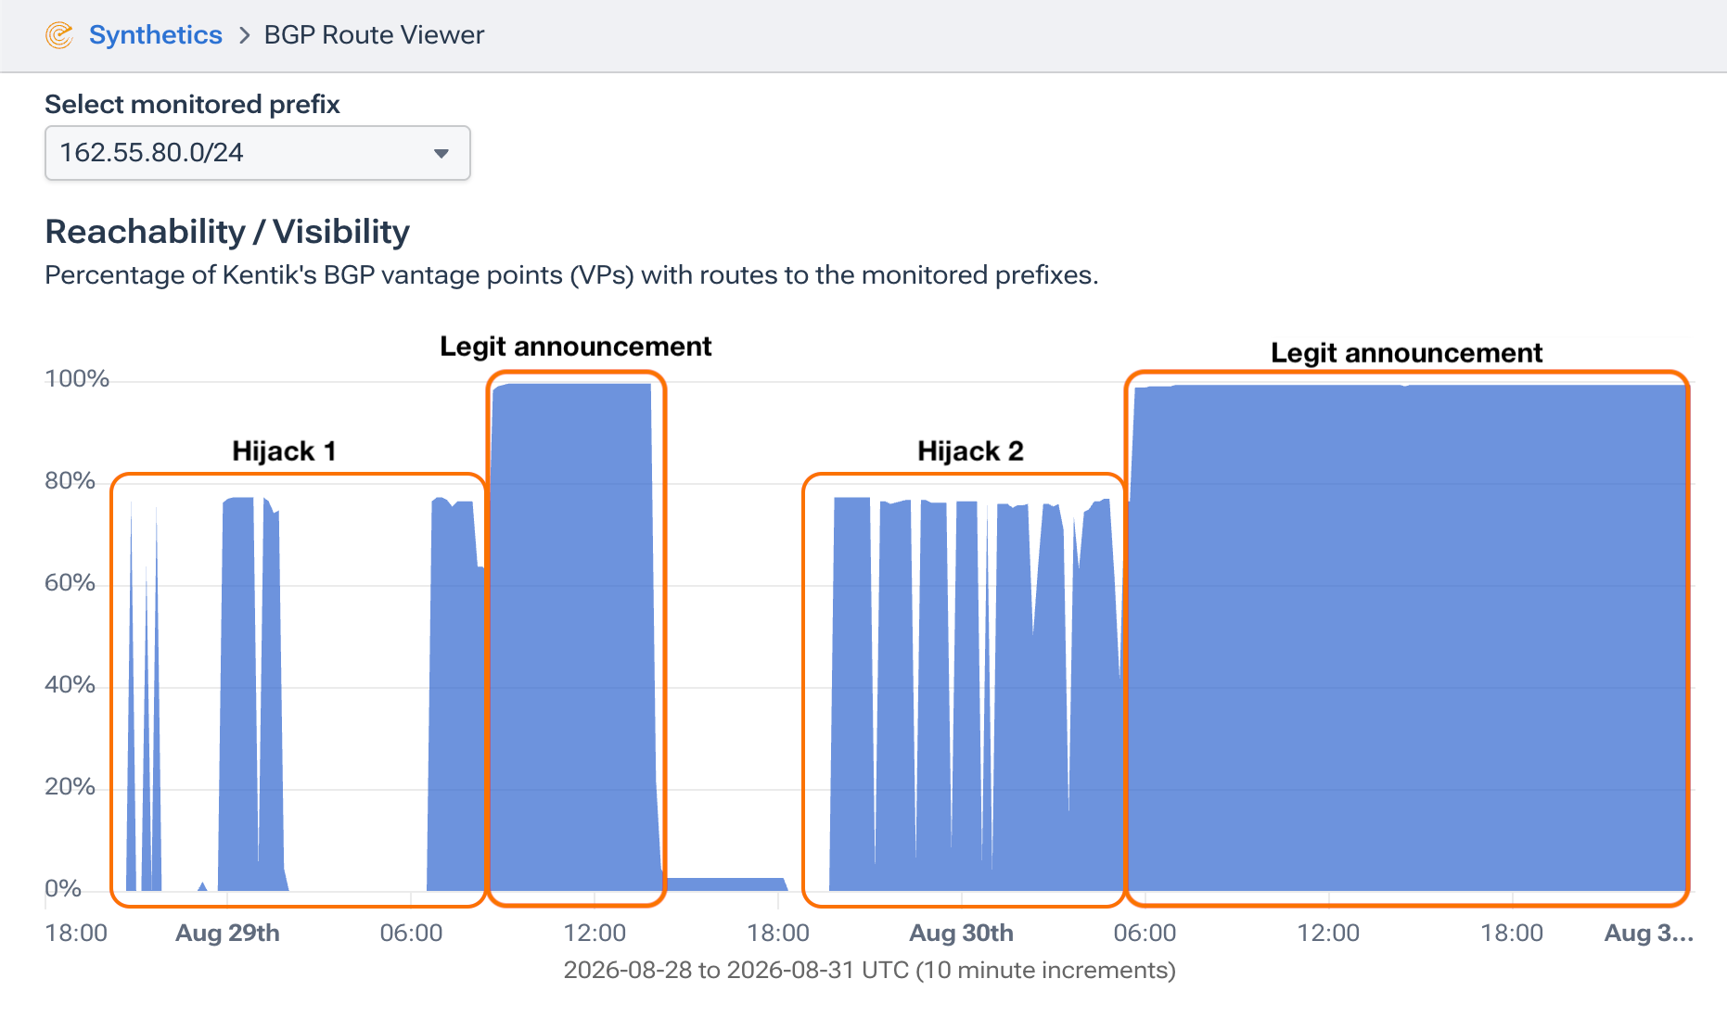
Real world attacks: Softaculous (Aug 2026)
Hijack included an AS path with a forged origin.
  The attacker appended 24940 as the rightmost ASN in the path
It was considered RPKI-valid for two reasons:
  ROA required the origin to be 24940
  ROA allowed prefix length to be anywhere from /16 to /24.
Because there was no existing route for 162.55.80.0/24, it propagated as far as other route filtering mechanisms would allow.
Because it was a more-specific route, any traffic destined for this IP range would prefer it over the legitimate route (162.55.0.0/16) due to routers’ preference for longest-prefix-match.
https://www.kentik.com/blog/latest-bgp-hijack-targets-hosting-software-vendor/

Slide 40
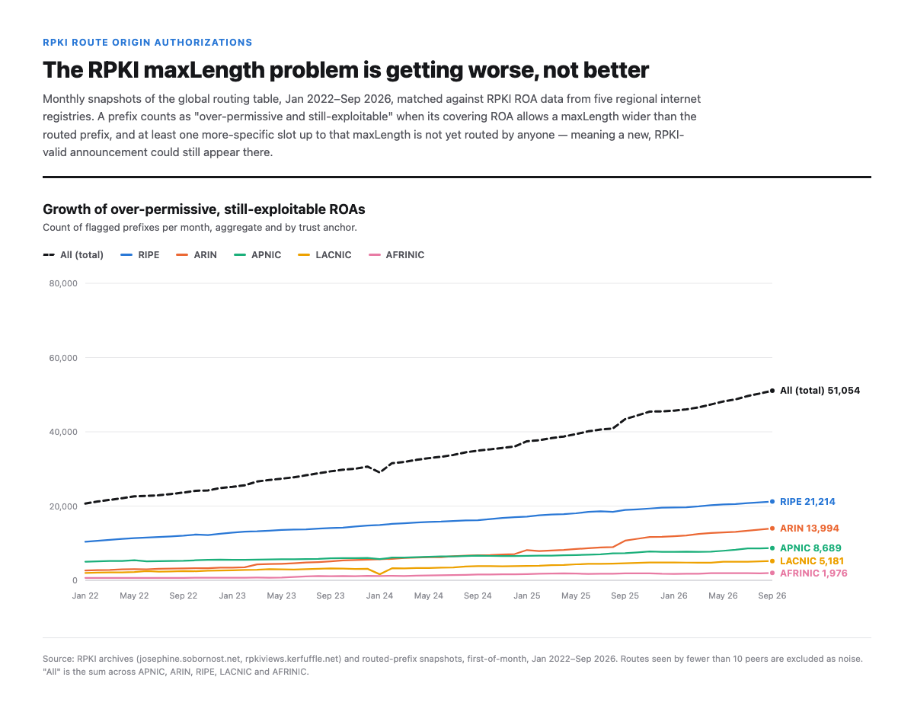
Real world attacks: Softaculous (Aug 2026)
Solution to non-minimal ROAs is outlined in RFC9319 (2022).
Primary fix:
  Avoid using the maxLength field in ROAs (it’s optional).
Main challenges are:
  Quick traffic engineering
  BGP-based DDoS mitigation
For those scenarios, limit the maxLength field to only prefix lengths that might ever be announced (typically one level beyond the routed prefix length).
~50,000 routes on the Internet are currently subject to a similar style of attack.
https://www.kentik.com/blog/latest-bgp-hijack-targets-hosting-software-vendor/

Slide 41
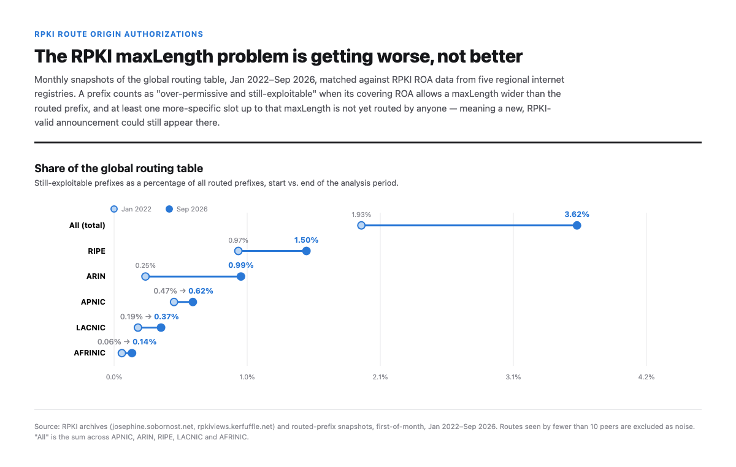

Slide 42
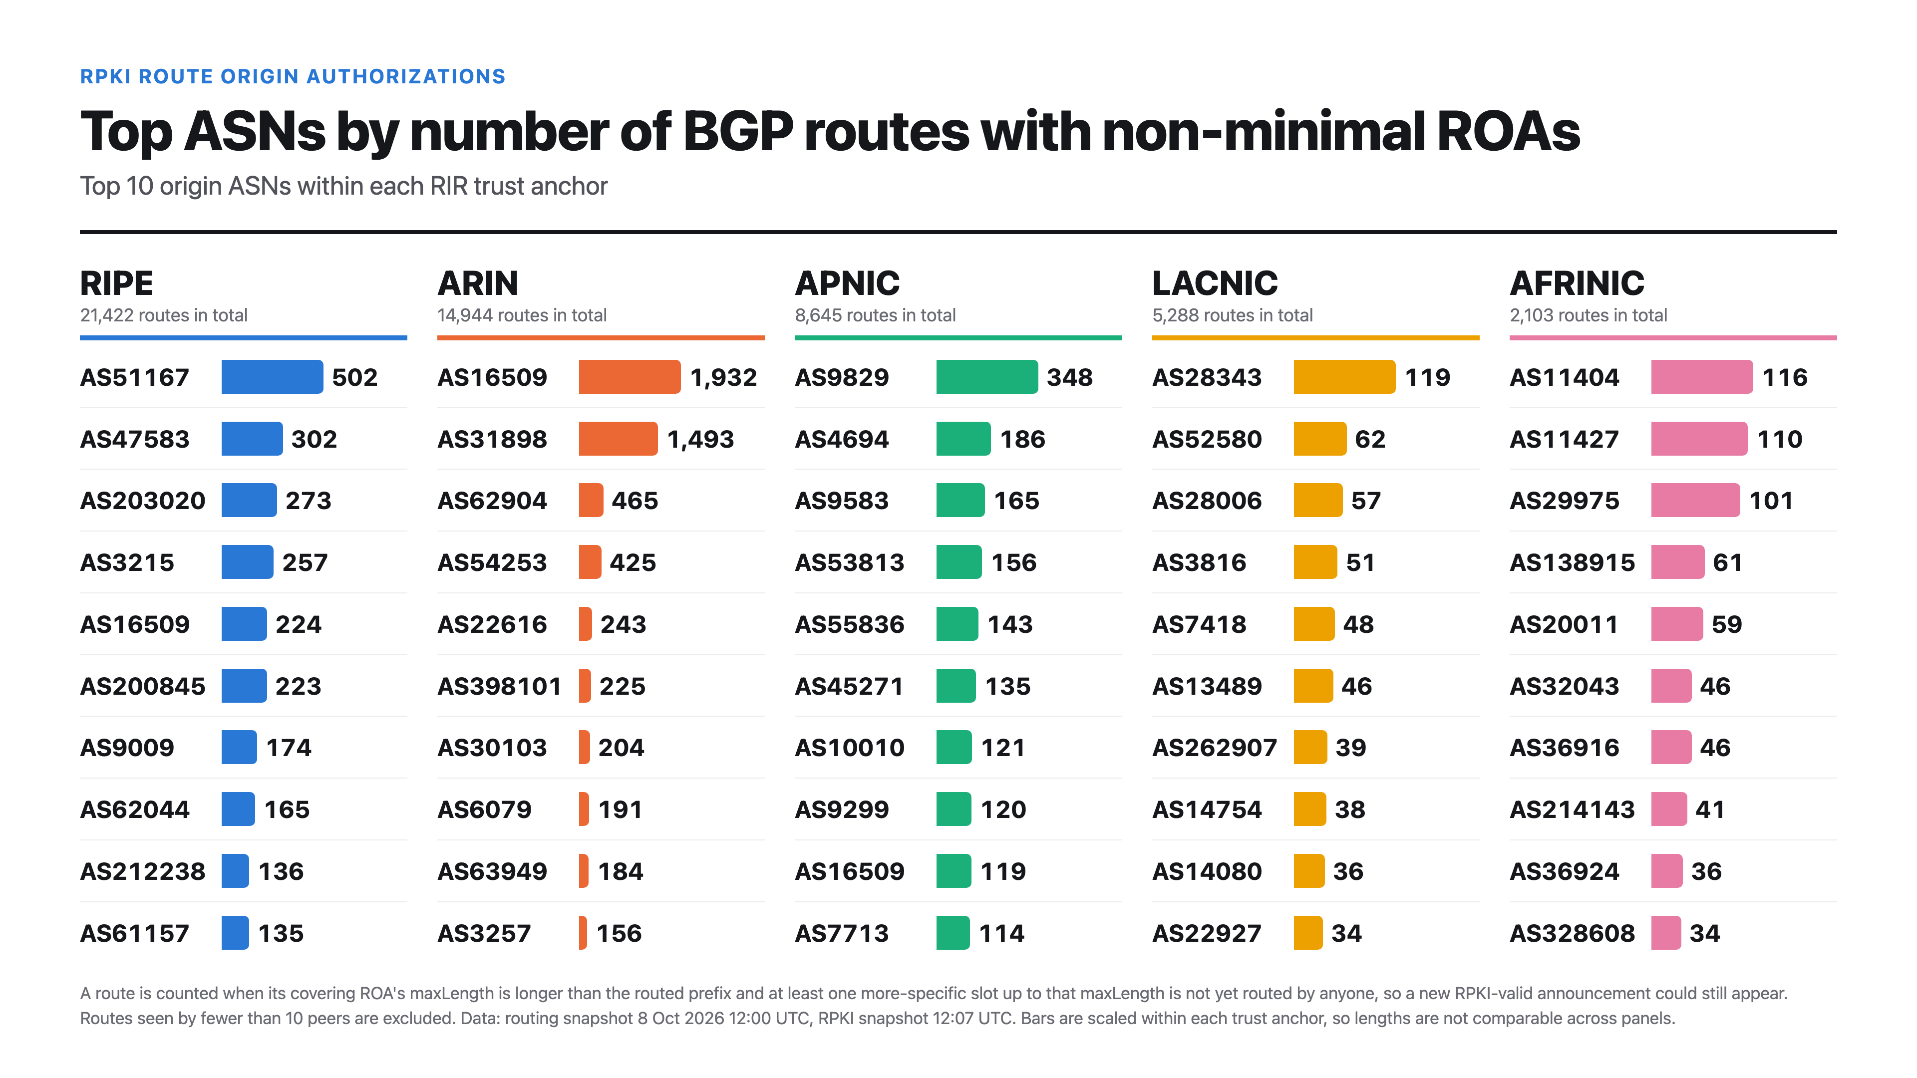

Slide 43
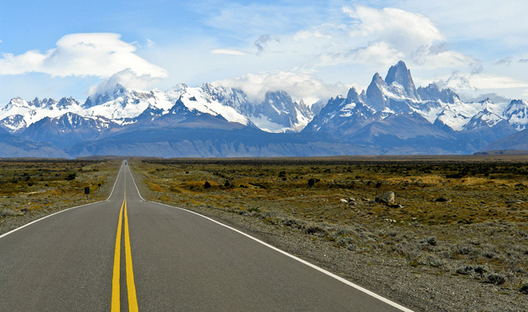
The road ahead
Notes:
Transition: we've covered what's changed and what hasn't. Now, where this is all headed.

Slide 44
What 17 years of watching BGP taught me
Geopolitical
Internet shutdowns and blockages aren’t ending anytime soon.
  As they become more sophisticated, they are becoming harder to measure.
  Iran 2026: routes stayed up while the country went offline. Only traffic data showed it.
Politics often shapes the paths that Internet traffic takes.
  From Cuba to Kherson, BGP followed politics.
Digital authoritarianism will continue to innovate.
  Other countries may adopt Iran’s allowlist system.
  The digital rights community needs support and resources.

Slide 45
What 17 years of watching BGP taught me
BGP security
We’ve made tremendous improvements!
  Large-scale, debilitating route leaks are largely a thing of the past.
  Most famous incidents couldn’t happen today.
The determined adversary finally gets its due.
  ROV, ASPA, and one day BGPSEC.
  The fight never stops. It’s a multi-year project.
To-do list:
Create ROAs (without maxLength) & reject invalids.
Create ASPA records (while at LACNIC 46)
Periodically review AS-SETs, routing policy, prepending.
  People overestimate what can be done in a year and underestimate what can be done in ten.
(attributed to Bill Gates)

Slide 46
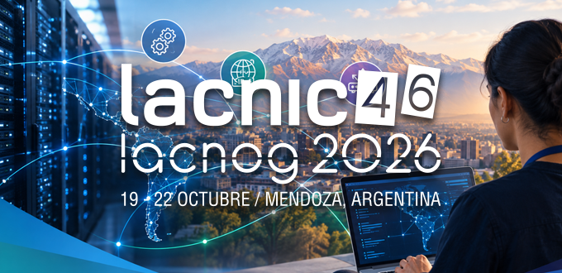
Siempre para adelante
The Internet is the defining technology of modern civilization.
  It is also a beautiful, remarkable, resilient thing.
How will we survive this time of AI adolescence?
  AI traffic volumes won’t break the Internet, but the pace of novel exploits could.
We can fix things collectively, and communities like LACNIC matter.
Notes:
Internet measurement is the story of modern times, and it has been an honor to help document it.

Slide 47

Thank you!
Doug Madory
dmadory@infoblox.com

